Slide 1





AI Integrated Smart Water Management System
Team : Shek Mohammed J
Email : Shekfarish28@gmail.com
Guide: (P.Raja, Master Trainer )
Disclaimer: The content is curated for educational purposes only.
Notes:
Slides: Prepare a short slide deck (10-12 slides) summarizing the project objectives, methodology, and key results.

Slide 2
OUTLINE
Abstract
Problem Statement
Proposed System/Solution
Algorithm & Deployment
GitHub Link
Project Demo(photos / videos)
Conclusion
Future Scope
References

Slide 3
Abstract
Water scarcity and resource mismanagement pose significant challenges tosustainable development. The AI-Integrated Smart Water ManagementSystem addresses these issues by utilizing artificial intelligence to optimizewater usage, reduce waste, and improve overall resource management. Thissystem leverages sensors, machine learning, and predictive analytics tomonitor water flow, detect leaks, and predict demand patterns acrossvarious sectors, including agriculture, urban areas, and industrialapplications. By analyzing real-time data, the AI system can automateirrigation schedules, adjust water distribution dynamically, and provideactionable insights for users, helping to promote sustainable water usage.This innovative approach not only enhances water conservation efforts butalso contributes to a more resilient and efficient water managementinfrastructure, aligning with goals for a sustainable future.

Slide 4
Problem Statement
Water scarcity and inefficient management of water resources arecritical global issues, exacerbated by population growth, urbanization,and climate change. Traditional water management systems lack theagility and intelligence needed to address real-time changes in waterdemand and supply, leading to significant water wastage, undetectedleaks, and suboptimal allocation of resources across agricultural, urban,and industrial sectors. Without advanced monitoring and automatedcontrol systems, communities are unable to respond effectively to watershortages, putting sustainability efforts at risk and hindering long-termwater security. The challenge lies in developing an intelligent,integrated solution that can accurately monitor water usage, predictdemand patterns, and optimize distribution in real time to minimizewaste and support sustainable water management practices acrossvarious applications.

Slide 5
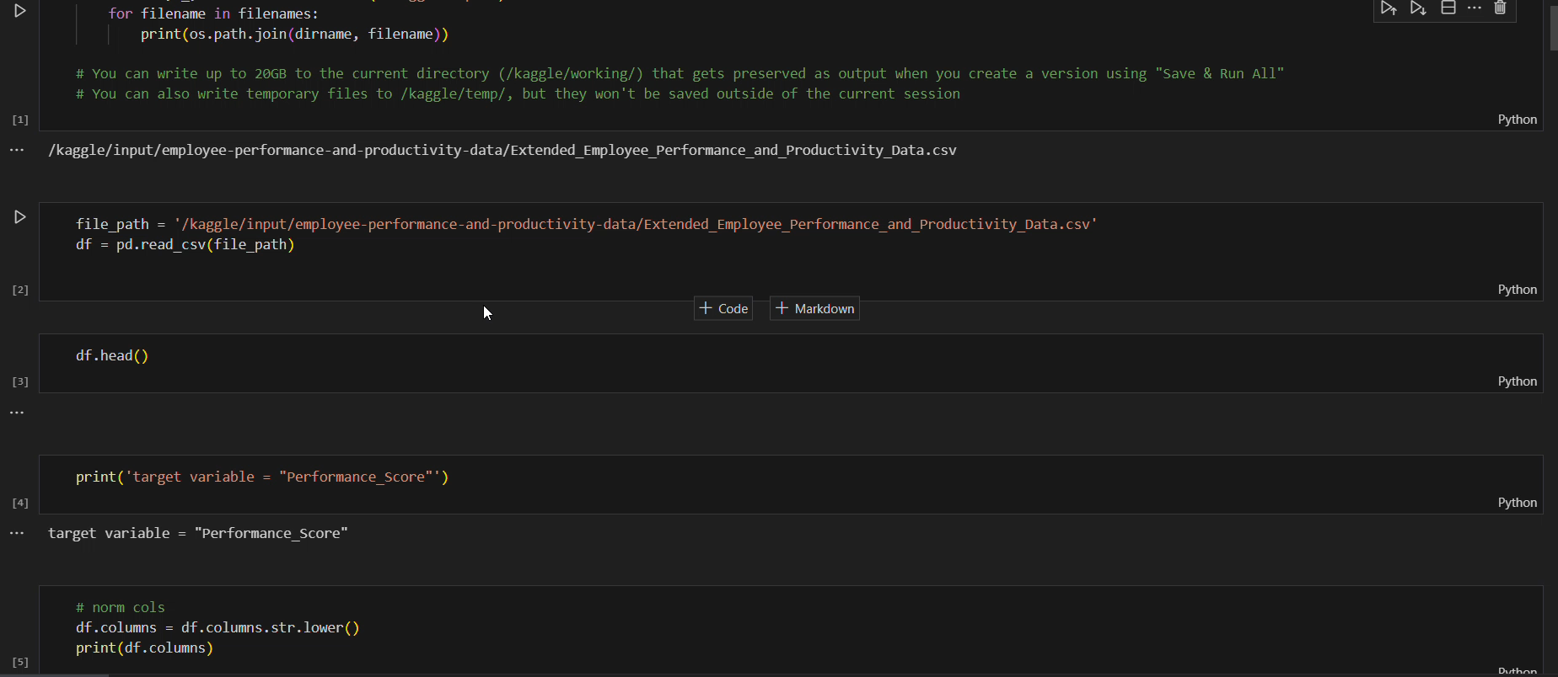
Video of Project Demo

Slide 6
Conclusion
This project successfully demonstrates an innovative approach to efficientwater management by leveraging AI, IoT, and automation technologies. Bycollecting real-time data from sensors, applying AI algorithms to analyze andpredict water usage, and enabling automated controls, this system caneffectively reduce water waste, detect leaks, and optimize water distribution.The AI-Integrated Smart Water Management System not only addressespressing issues in water scarcity and resource management but also offers ascalable, flexible solution adaptable to various settings, from urban areas toagricultural lands. With capabilities for real-time monitoring, anomalydetection, and user engagement, this system empowers users and managersalike to make informed, data-driven decisions. Ultimately, the projectsupports the goal of sustainable water use, contributing to both environmentalconservation and economic savings. This approach showcases a practical andimpactful way to leverage technology for one of the world’s most criticalresource

Slide 7
Future Scope
Real-time
AI-driven
cross-industry
personalized
predictive.

Slide 8
Thank you!
Notes:
thank you very much for joining this PPT, keep learning.
8

